Slide 1

PRACTICAL SUBMISSION Python for Data Science
Presented By: Amit Sharma
[Bsc Data Science]
Presented To: Mr. Aishwary Shukla
[Assistant professor],
AAFT (SODS)
AAFT | SODS | 2024

Slide 2
Topics
1. INTRODUCTION TO PYTHON
2. PYTHON DATA STRUCTURES
3. ERROR HANDLING IN PYTHON
4. PYTHON LIBRARIES (NUMPY, PANDAS, MATPLOTLIB
5. OOPs IN PYTHON
6. UNIVARIATE, BIVARIATE & MULTIVARIATE ANALYSIS
7. DATA PROCESSING
8. MACHINE LEARNING PIPELINE
9. LOGISTIC REGRESSION
10. DECISION TREE

Slide 3
introduction to python
Python is a dynamically typed, general purpose programming language that supports an object-oriented programming approach as well as a functional programming approach.
Python is an interpreted and a high-level programming language.
It was created by Guido Van Rossum in 1989.

Slide 4
key features of python
Readable and Simple Syntax: Easy to read and write.
Interpreted: Code is executed line-by-line.
Dynamically Typed: No need to declare variable types.
Extensive Standard Library: Many built-in modules and functions.
Cross-Platform: Runs on multiple operating systems.
Community Support: Active community for help and development.
Object-Oriented: Supports object-oriented programming principles.
Versatile: Used for web development, data analysis, AI, etc.

Slide 5
python lists
Lists are ordered collection of data items.
They store multiple items in a single variable.
List items are separated by commas and enclosed within square brackets [].
Lists are changeable meaning we can alter them after creation.
Example 1:
lst1 = [1,2,2,3,5,4,6]
lst2 = ["Red", "Green", "Blue"]
print(lst1)
print(lst2)
Output:
[1, 2, 2, 3, 5, 4, 6]
['Red', 'Green', 'Blue']

Slide 6
python tuples
Tuples are ordered collection of data items. They store multiple items in a single variable. Tuple items are separated by commas and enclosed within round brackets ().
Tuples are unchangeable meaning we can not alter them after creation.
Example 1:
tuple1 = (1,2,2,3,5,4,6)
tuple2 = ("Red", "Green", "Blue")
print(tuple1)
print(tuple2)
Output:
(1, 2, 2, 3, 5, 4, 6)
('Red', 'Green', 'Blue')
Example 2:
details = ("Abhijeet", 18, "FYBScIT", 9.8)
print(details)
Output:
('Abhijeet', 18, 'FYBScIT', 9.8)

Slide 7
dictionary
Dictionaries are ordered collection of data items. They store multiple items in a single variable. Dictionary items are key-valuepairs that are separated by commas and enclosed within curly brackets {}.
Example:
info = {'name':'Karan', 'age':19, 'eligible':True}
print(info)
Output:
{'name': 'Karan', 'age': 19, 'eligible': True}
Accessing items:
Example:
info = {'name':'Karan', 'age':19, 'eligible':True}
print(info['name'])
print(info.get('eligible'))
Output:
Karan
True

Slide 8
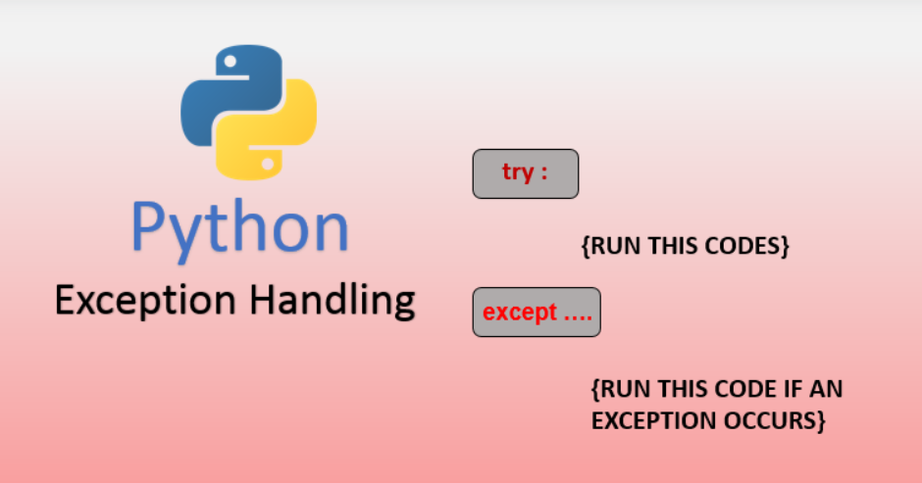

Slide 9
error and exception in python
Errors: Errors in Python are typically categorized as syntax errors or runtime errors.
Syntax Errors: Syntax errors occur when the Python parser encounters code that violates the language syntax rules. These errors are detected during the parsing stage before the code is executed. Common examples include missing parentheses, incorrect indentation, or misspelled keywords.
Example of a syntax error:
print("Hello world" # Missing closing parenthesis
Runtime Errors (Exceptions): Runtime errors, also known as exceptions, occur during the execution of a program. These errors interrupt the normal flow of the program. Runtime errors can be caused by various factors, such as invalid input, division by zero, or accessing an index out of range. Python provides mechanisms to handle exceptions gracefully using try, except, else, and finally blocks.
Example
result = 10 / 0 # ZeroDivisionError: division by zero

Slide 10
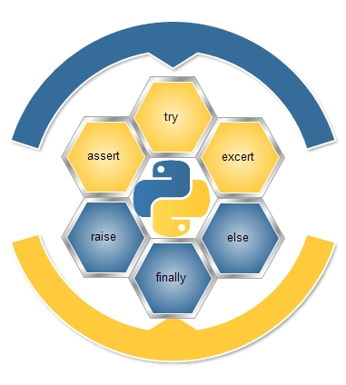

Slide 11
exception handling
Exception handling is the process of responding to unwanted or unexpected events when a computer program runs. Exception handling deals with these events to avoid the program or system crashing, and without this process, exceptions would disrupt the normal operation of a program.
Exceptions in Python
Python has many built-in exceptions that are raised when your program encounters an error (something in the program goes wrong).
When these exceptions occur, the Python interpreter stops the current process and passes it to the calling process until it is handled. If not handled, the program will crash.
Python try...except
try….. except blocks are used in python to handle errors and exceptions. The code in try block runs when there is no error. If the try block catches the error, then the except block is executed.
Syntax:
try:
#statements which could generate
#exception
except:
#Soloution of generated exception

Slide 12
finally clause
The finally code block is also a part of exception handling. When we handle exception using the try and except block, we can include a finally block at the end. The finally block is always executed, so it is generally used for doing the concluding tasks like closing file resources or closing database connection or may be ending the program execution with a delightful message.
Syntax:
try:
#statements which could generate
#exception
except:
#solution of generated exception
finally:
#block of code which is going to
#execute in any situation
The finally block is executed irrespective of the outcome of try……except…..else blocks
One of the important use cases of finally block is in a function which returns a value.

Slide 13
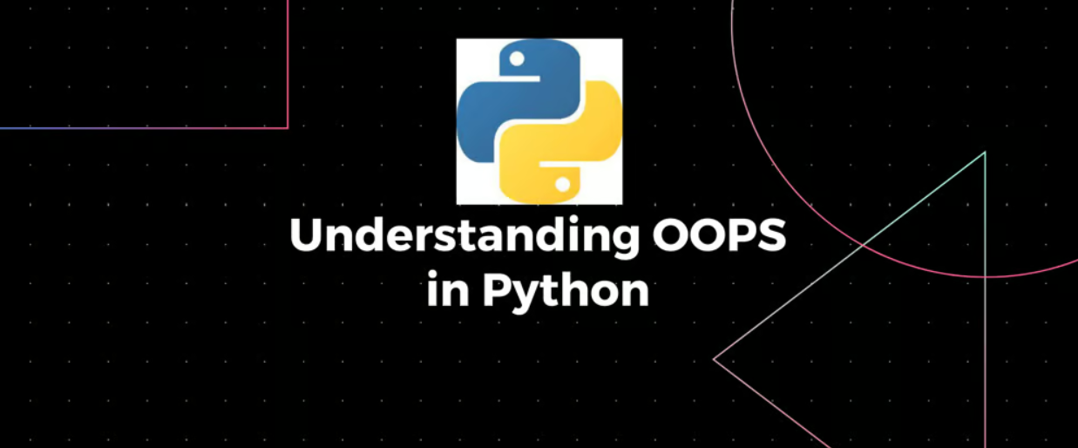

Slide 14
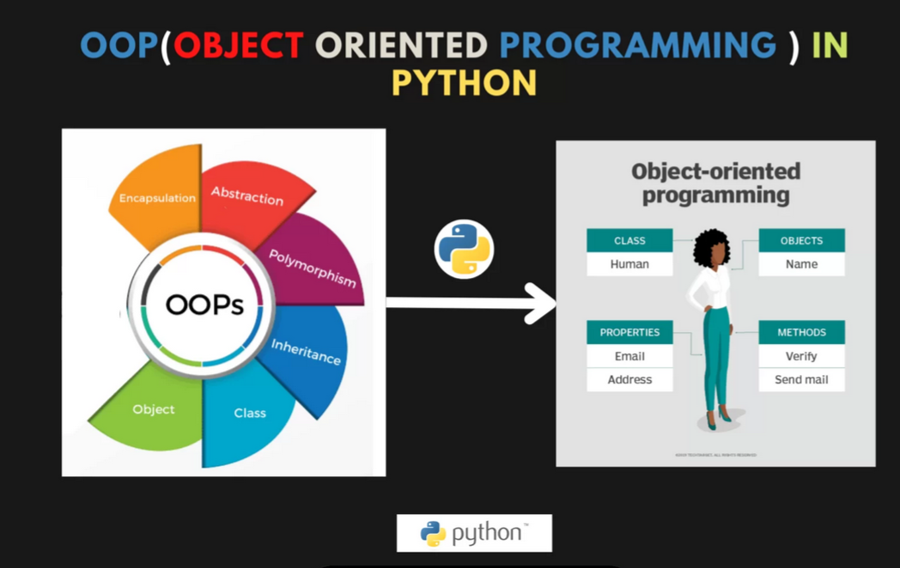

Slide 15
numpy
NumPy is a numerical computing library in Python that provides support for large, multi-dimensional arrays and matrices, along with a collection of mathematical functions to operate on these arrays.
Usage:
Scientific Computing: Used in simulations, modeling, and other scientific applications requiring numerical calculations.
Data Analysis: Underpins many data manipulation operations, providing the foundation for libraries like Pandas.
Machine Learning: Often used for pre-processing data, feature extraction, and implementing machine learning algorithms.
Mathematical Computations: Supports a wide range of mathematical functions for operations on arrays and matrices.
Performance Optimization: Enhances the performance of numerical operations through efficient implementations.

Slide 16
Pandas
Pandas is a data manipulation and analysis library in Python that provides data structures and functions needed to manipulate structured data efficiently.
Usage:
Data Analysis: Facilitates exploration and analysis of large datasets through descriptive statistics and data visualization.
Data Cleaning and Preparation: Tools for handling missing values, duplicates, and applying transformations to data.
Exploratory Data Analysis (EDA): Enables quick insights and summary statistics of datasets.
Time Series Analysis: Provides powerful capabilities for handling time-indexed data.
Data Merging and Joining: Functions for combining multiple datasets based on common keys or indices.
Data Exporting and Importing: Read from and write to various file formats (CSV, Excel, SQL databases, etc.).

Slide 17
Matplotlib
Matplotlib is a Python library used for creating static, animated, and interactive visualizations in a wide range of formats. It provides tools for generating various types of plots and charts, including line plots, scatter plots, bar charts, histograms, and more. Matplotlib is highly customizable, allowing users to adjust colors, labels, legends, and other elements of the plot.
Matplotlib Usage
Data Visualization: Create a wide range of static, animated, and interactive visualizations.
Plot Types: Supports line plots, scatter plots, bar charts, histograms, pie charts, and more.
Customization: Highly customizable with options to adjust colors, labels, legends, and axes.
Integration: Works well with other Python libraries like NumPy and Pandas.
Interactive Plots: Generate interactive plots in Jupyter Notebooks and other interactive environments.
Publication Quality: Produce high-quality figures suitable for publication in scientific journals and reports.

Slide 18
Univariate, bivariate & multivariate analysis
Univariate: Analysis or visualization involving a single variable. It focuses on understanding the distribution, central tendency, and dispersion of a single variable. Common univariate techniques include histogram, kernel density estimation (KDE) plots, box plots, and bar plots.
Bivariate: Analysis or visualization involving two variables. It explores the relationship between two variables, examining how changes in one variable may affect the other. Common bivariate techniques include scatter plots, line plots, and correlation analysis.
Multivariate: Analysis or visualization involving three or more variables. It examines relationships and patterns among multiple variables simultaneously. Multivariate techniques include heatmaps, pair plots, and 3D scatter plots. It's useful for understanding complex interactions and dependencies among variables.

Slide 19
data processing
Data processing is the conversion of raw data into a usable format through various steps like collection, cleaning, transformation, analysis, and interpretation.
Data Collection: Gathering raw data from various sources.
Data Cleaning: Identifying and rectifying errors in the data.
Data Transformation: Converting data into a suitable format for analysis.
Data Integration: Combining data from multiple sources into a unified dataset.
Data Reduction: Reducing the size of the dataset while preserving essential characteristics.
Data Aggregation: Summarizing and condensing data into more manageable forms.
Data Analysis: Applying analytical techniques to derive insights from the data.
Data Visualization: Presenting analyzed data visually for effective communication.
Data Interpretation: Drawing conclusions and making decisions based on data analysis.
Data Storage and Management: Storing processed data and managing access and security.
These steps collectively form the data processing pipeline, transforming raw data into actionable insights.

Slide 20
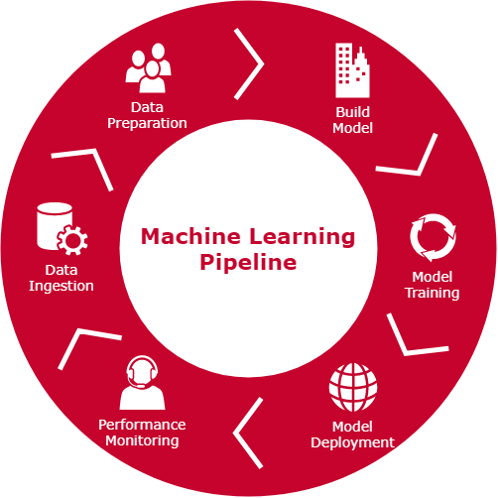
machine learning pipeline

Slide 21
logistic regression
Model Type: Binary classification method modeling the probability of a binary outcome.
Representation: Uses the logistic function to map predicted values to probabilities between 0 and 1.
Decision Boundary: Calculates a linear decision boundary to separate classes.
Cost Function: Minimizes logistic loss function or binary cross-entropy loss during training.
Training: Optimizes model parameters (weights) using techniques like gradient descent.
Prediction: Assigns new inputs to classes based on probability thresholds.
Analysis:
Interpretability: Provides interpretable results with feature coefficients.
Linear Assumption: Assumes linear relationship between features and target log-odds.
Assumptions: Requires independence of observations and linear relationship.
Use Cases: Widely used in various domains like healthcare, finance, and marketing.
Performance: Simple and effective, but may not capture complex relationships as well as more advanced models.

Slide 22
decision tree
Model Type: Supervised learning algorithm used for classification and regression tasks.
Representation: Hierarchical tree structure with decision nodes and leaf nodes.
Splitting Criteria: Chooses features and splits data at each node to maximize information gain (for classification) or minimize impurity (for regression).
Decision Making: Makes predictions by traversing the tree from the root to a leaf node based on feature values.
Interpretability: Provides interpretable rules for decision-making, easy to visualize.
Handling Non-linearity: Can capture non-linear relationships between features and target variable.
Overfitting: Prone to overfitting, especially with deep trees and noisy data.
Ensemble Methods: Can be combined with ensemble methods like Random Forests or Gradient Boosting to improve performance and reduce overfitting.

Slide 23
analysis of decision tree.
Interpretability: Offers intuitive rules for decision-making, allowing stakeholders to understand and trust the model.
Bias-Variance Tradeoff: Balances the tradeoff between bias and variance by controlling tree depth or pruning.
Feature Importance: Provides insight into feature importance, helping identify key factors driving predictions.
Non-parametric: Does not make assumptions about the distribution of data, suitable for non-linear relationships.
Data Preprocessing: Less sensitive to feature scaling and outliers compared to some other algorithms.
Performance: Can perform well on both small and large datasets, but may not always achieve the highest accuracy compared to more complex models.

Slide 24


Thank you
https://github.com/Amit123456777
https://www.linkedin.com/in/amit-sharma-868b3a23a/
amsharma2607@gmail.com

